Slide 1















Neuromorphic Hardware EBL Pattern

Slide 2












Neuromorphic Hardware EBL Pattern

Slide 3






























Neuromorphic Hardware: Connect to nodes

Slide 4










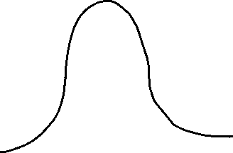

Neuromorphic Hardware: Connect to nodes

Slide 5





Neuromorphic Hardware EBL Pattern

